Slide 1
Udyog Saarthi (Progressive Web-based Application)
CSE7101- Capstone Project
Review-1
Batch Number: CSE_20
Under the Supervision of,
Ms. Saiqa Khan - Assistant Professor
Mr. Thatimakula Saikumar – Assistant Professor
School of Computer Science and Engineering
Presidency University
Roll Number | Student Name
20221CSE0307 20221CSE0306 20221CSE0673 | PRIYANKA G PRIYADARSHINI HANSRAJ
Name of the Program: Computer Science and Engineering
Name of the HoD: Dr.Asif Mohammed , Dr.Blessed Prince
Name of the Program Project Coordinator: Dr.Jayavadivel Ravi , Mr.Muthuraju V
Name of the School Project Coordinators: Dr. Sampath A K , Dr. Geetha A

Slide 2
Content
Problem Statement
Objectives
Background and Related work for title Selection
Analysis of Problem Statement
Innovation or Novel Contributions
Git-hub Link
Tech stacks used
Timeline of the Project
References

Slide 3
Problem Statement Number: PSCS-39
Organization: Ministry of Social Justice and Empowerment
Category : Software
Problem Description:
A large number of Persons with Disabilities (PwDs) in India, especially under the D & E categories(Intellectual Disability, Autism Spectrum Disorder, Multiple Disabilities, Mental Illness, Specific Learning Disabilities) of the 4% reservation, remain unemployed due to lack of awareness, inaccessible job information, and limited digital literacy.
Existing portals fail to provide simplified, accessible, and timely updates, resulting in missed opportunities.
There is a need for an inclusive Progressive Web App to bridge this gap with curated job listings, multi-language/audio support, offline access, and real-time notifications.

Slide 4
Objectives :
1. Create an easy-to-use web app to share job and training opportunities for PwDs.
Show job details in simple language, multiple languages, and with audio support.
Send instant alerts for new jobs, deadlines, and training programs.
Allow users to view jobs even without an internet connection.
Make the app fully accessible for all types of disabilities.
Help users match their skills to jobs and track their applications.

Slide 5
Background and Related work for title Selection :
Background
In India, 64% of Persons with Disabilities (PwDs) are unemployed.
The government has a 4% job reservation for PwDs, but many still miss out.
Main reasons: lack of awareness, hard-to-read job information, low digital skills, and late updates.
Current job platforms are not fully accessible for PwDs, especially in D & E categories.
Related Work
Employment News Online – Shares jobs but no audio or simple language support.
National Career Service (NCS) Portal – Has job listings but not PwD-friendly.
NGO Training Apps – Teach skills but do not connect directly to government job updates.
Key Need
A single, easy-to-use platform with job info, training details, real-time alerts, and offline access for PwDs.

Slide 6
Analysis of Problem Statement
Analysis of Problem Statement :
Many PwDs under D & E categories are unaware of job opportunities due to inaccessible formats and lack of simplified communication.
Existing portals are complex and not designed for users with intellectual or learning disabilities.
Information is often available only in English or complicated technical language, making it harder to understand.
No central platform exists to combine job listings, training resources, and notifications for PwDs.
Lack of offline access means people in rural or low-internet areas miss updates.
Without timely alerts, many deadlines are missed, reducing chances of employment.

Slide 7
Innovation or Novel Contributions
.
Accessibility-first design – Built for PwDs with WCAG 2.1 standards (Web Content
Accessibility Guidelines version 2.1.), ARIA roles, high-contrast mode, and keyboard navigation.
Multi-language & audio support – Job details available in simple language, multiple languages, and text-to-speech for easy understanding.
Real-time notifications – Alerts for new jobs, deadlines, and training programs.
Offline mode – Access job listings and resources without internet.
Skill mapping & application tracking – Suggests jobs based on user skills and tracks application progress.
Centralized platform – Combines job listings, training information, and government opportunities in one place.

Slide 8
Github link and Tech Stack :
Git-hub Link : https://github.com/Priyankagowda0707
Tech Stack :
Frontend: HTML , CSS , Javascript , React.js , Web Speech API
Backend: Node.js + Express.js, MongoDB, Firebase
Others: GitHub, Vercel/Netlify,

Slide 9
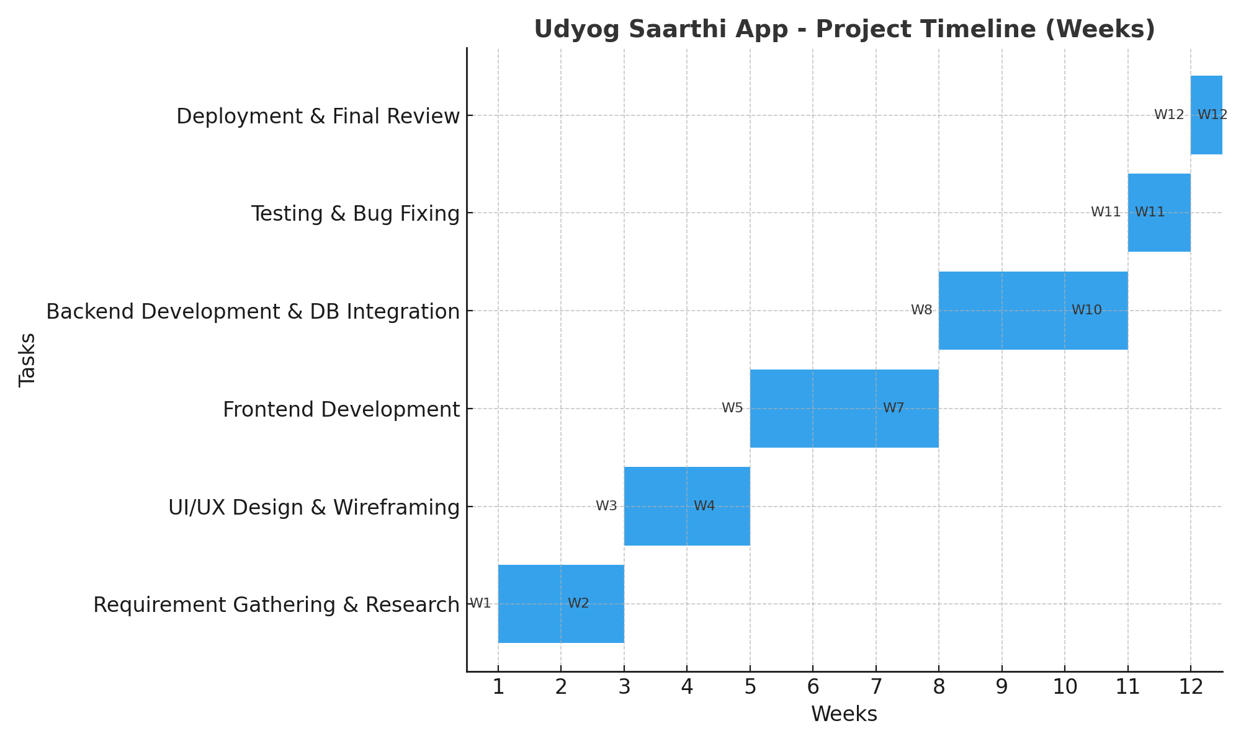
Timeline of the Project :
review 1: Requirement gathering & research
review 2: UI/UX design
review 3: Frontend development
review 4: Backend development & database integration
review 5: Deployment & final review

Slide 10
References (IEEE Paper format)
[1] Ministry of Statistics and Programme Implementation, 'Persons with Disabilities in India – A Statistical Profile', Government of India, 2021.
Available : https://cdnbbsr.s3waas.gov.in/s3e58aea67b01fa747687f038dfde066f6/uploads/2024/10/2024102947528543.pdf
[2] Employment News Online, 'Government Job Opportunities Portal', 2024.
Available : https://www.indgovtjobs.in/2024/
[3] World Health Organization, 'World Report on Disability', WHO, 2011.
Available : https://www.who.int/teams/noncommunicable-diseases/sensory-functions-disability-and-rehabilitation/world-report-on-disability

Slide 11


